Slide 1

Terna Engineering College, Nerul
Computer Engineering Department
“Flappy Bird Game”
Presented by
Mr. Ved Thakur (B03)
Mr. Faraz Hussain (B17)
Mr. Kunal Dongre (B18)
Under the Guidance of
Professor Pramila Mate

Slide 2
Contents
Introduction
Literature survey
Aim
Objectives
Scope
Proposed Algorithm
Implementation (proposed system )
Result and discussion
Conclusion
References

Slide 3
Introduction
Flappy bird, a small game but made a great success, earned 4 million a year. But this game is really hard to play. This is a 2D game, and there is a bird flying towards, the bird is motionless horizontally in the screen, but the back-ground is moving backwards, it makes us feel the bird is flying towards.
Flappy Bird is a very popular mobile game on Android platform, driving a lot of people crazy. Flappy Bird is a 2013 game, developed by Vietnam-based developer Dong Nguyen and published by GEARS Studios, a small independent game developer also based in Vietnam.

Slide 4
Literature Survey
Flappy bird is a game in which the player guides the bird, which is the "hero" of the game through the space between pairs of pipes. At each instant there are two actions that the player can take: to press the ‘left mouse button’, which makes the bird jump upward or not pressing any key, which makes it descend at a constant rate.
Flappy bird is a side-scroller game where the player controls a bird, attempting to fly between columns of green pipes. The bird will be flying until it collisions with a pipe or it fall on ground. It’s a simple game of infinite level type.

Slide 5
Aim
We choose game for our software project. Actually game is entertaining for anybody and in leisure time we can spend our time nicely by playing game. Our flappy bird game implemented for only desktop.
In this project, we design and implement a new version of flappy bird. It is a pygame program written in python.

Slide 6
Objectives
The objective is to side-scroll where the player controls a bird, attempting to fly between rows of green pipes without hitting them. The objective is to direct a flying bird, named Flappy who moves continuously to the right, between sets of Mario-like pipes. If the player touches the pipes, they lose. Flappy briefly flaps upward each time that the player clicks the left mouse button; if the screen is not tapped, Flappy falls because of gravity; each pair of pipes that he navigates between earns the player a single point.

Slide 7
Scope
The game has an amazing interface with soothing background music playing whenever the game loads. The player can play this game in their leisure time and enjoy their free time.
Our game has a main menu where the user can choose whether to start the game or quit the game.
As soon as the game starts, the bird appears to be flying. Horizontal and vertical pipe acts as an obstacle/ hurdle for our bird.
Score and Maximum score of the player are displayed onto the screen.

Slide 8
Proposed Algorithm
Content
How games work.
How pygame works.
Flowchart of the game.
Basic Terminologies
Understanding the physics of the game.
Understanding the logic of the game.

Slide 9
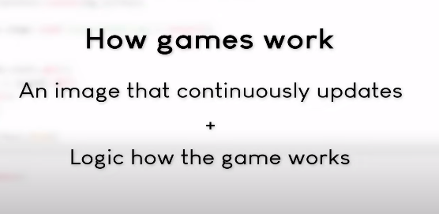
How games work
To create any kind of game we need to know two foundational concepts:
We must be able to draw a picture on the screen and continuously update it.
Logic of how game will work.

Slide 10
But python cannot draw images, nor can get the user input that the games needs.
But many different modules are available in python for game development.
Few are:
Pygame
Pyglet
Arcade

Slide 11
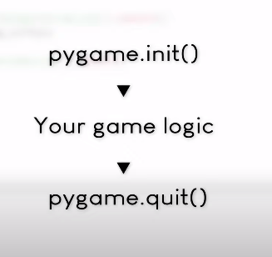
How pygame works
The very first thing we need to do is install the pygame module as it is an external module.
pip install pygame
Architecture of pygame:

Slide 12
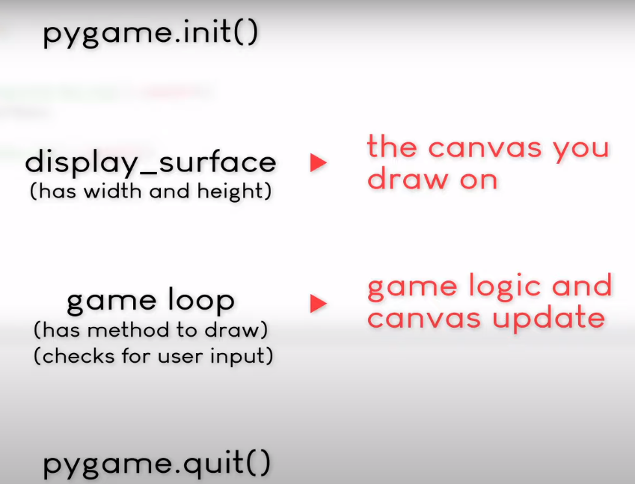

Slide 13
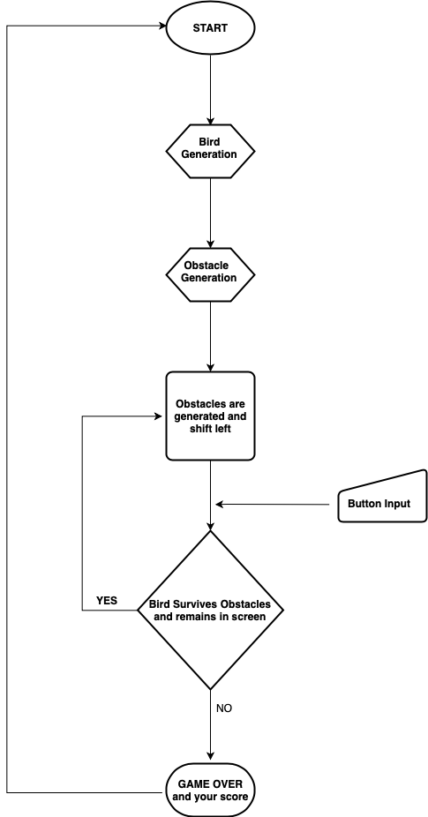
Flowchart of the game

Slide 14
Basic Game Terminologies
Frames per second(FPS)
How many pictures(/Frames) a game draws in a single second.
They influence how fast and fluid a game runs
Example:
100 FPS = 100 * 5px = 500px per second.
Implemented in python by using:
clock object.
Example:
clock = pygame.time.Clock()
clock.tick(120) # 120 frames per second
Note: If we have unstable framerate, it would affect the user experience.

Slide 15
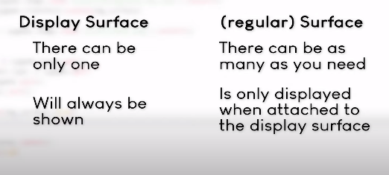
Display surface and regular surfaces

Slide 16
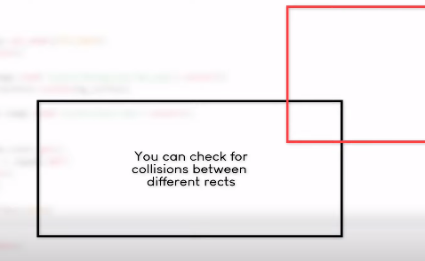
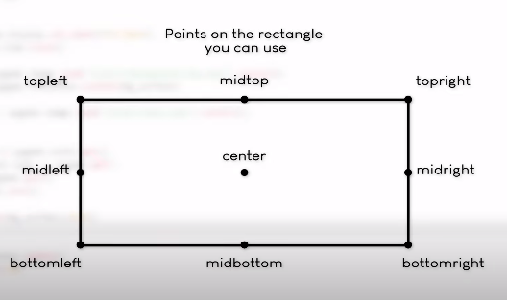
Rects
We can check collisions by drawing rectangles around the screen
More control on how to place the object.
Can rotate the rectangle so that corresponding object will also get rotated

Slide 17
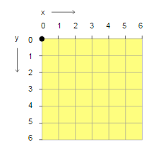
Screen Co-ordinate System

Slide 18
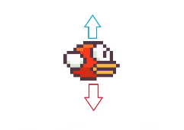
Understanding the physics of the game
Centre of the screen is on top- left corner of the screen
Blue Upward Arrow:
Left mouse button clicked
Against gravity
Decrement the value of y
Red Downward Arrow:
No button clicked
Apply gravity
Increment the value of y

Slide 19
Understanding the logic of the game
Animation
Animation is done by constantly changing the images and displaying in on the screen

Slide 20
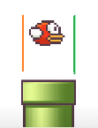
Counting the score
If the bird passes through the
orange line, it means that the bird
enters the pipe.
Green line indicates that the bird
has successfully passed the pipe.
and has not collided with the pipe,
so increment the value of the score.

Slide 21
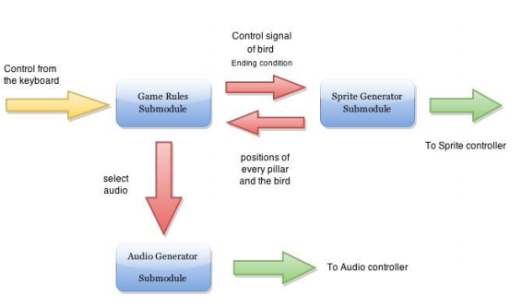
Game logic block diagram

Slide 22
Impementation
Flow Of Application :-
Main Menu
Start Game
Restart Game
Quit game – Can be quitted anytime by clicking the x button on top-right hand side of the screen

Slide 23
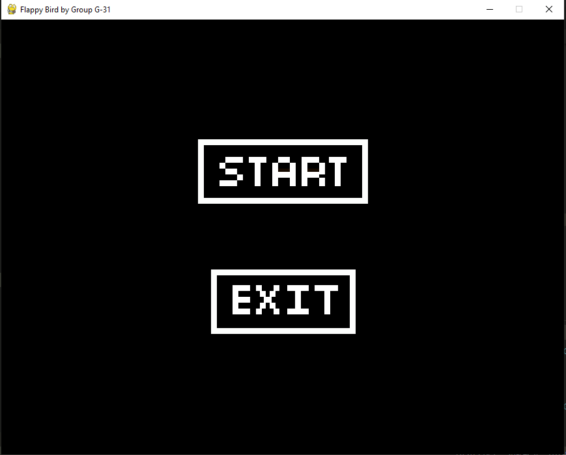

Slide 24
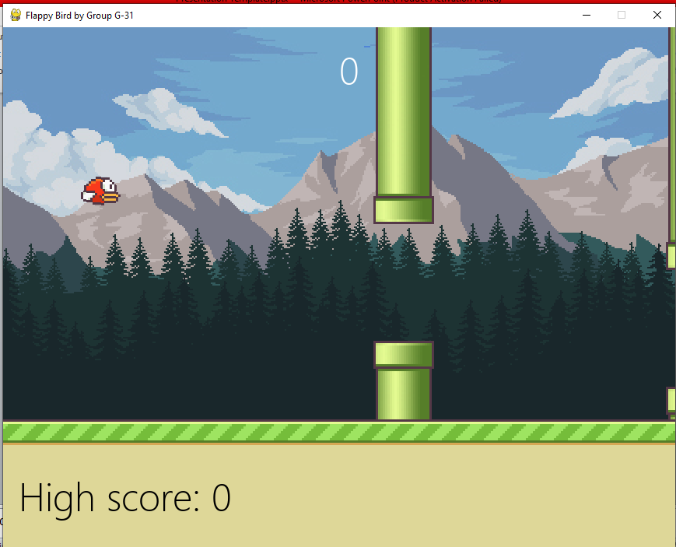

Slide 25
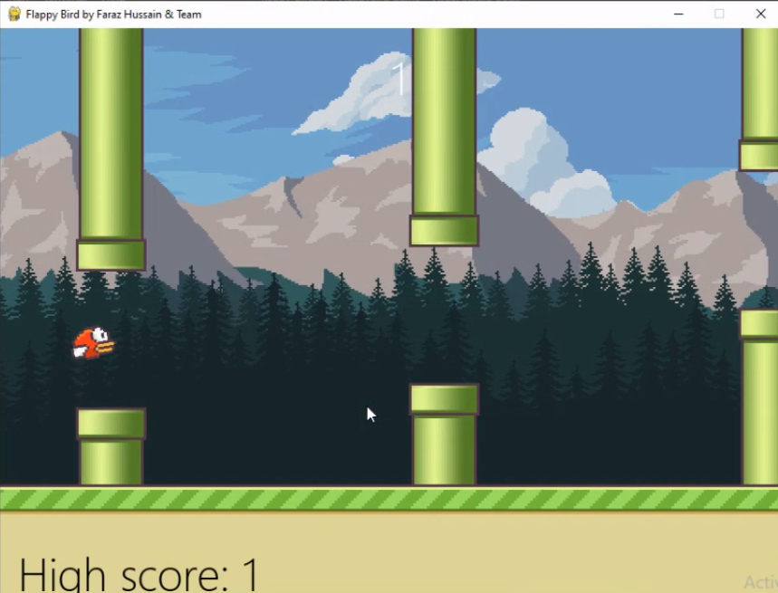

Slide 26
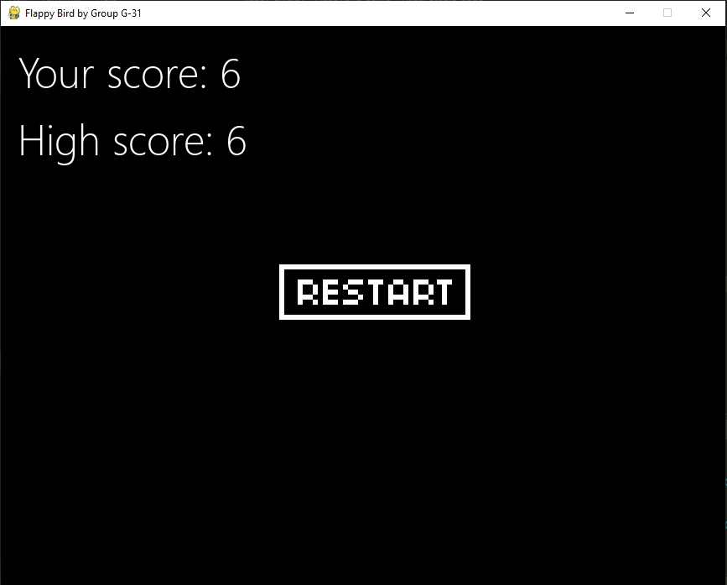

Slide 27
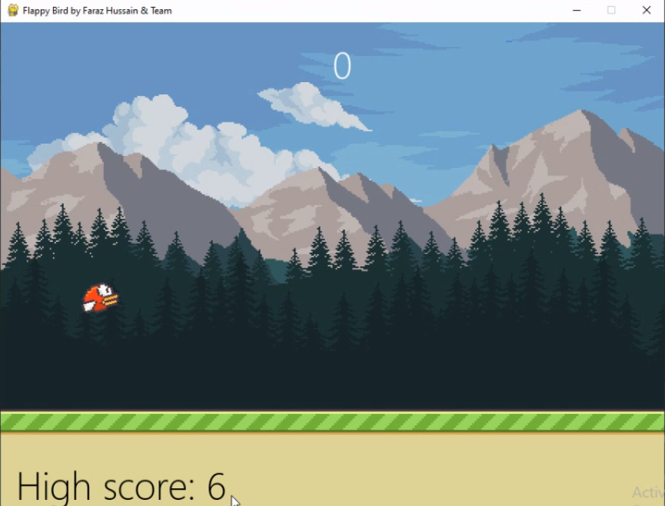

Slide 28
Result
Our final project was planned, developed and demonstrated as expected. We designed a new version of Flappy Bird Game written in Python, which could be played either on personal computer. Firstly, a user-friendly interface was implemented.

Slide 29
Conclusion
Working on this project gave us the opportunity to test our understanding of Python; how different functions would be extended on a larger scale project, as well as how basic data types like strings and arrays come together to provide inheritance on a larger scale.
The concept of Object-Oriented Programming was successfully studied and implemented by creating various classes and inheriting from the parent class as so on and so forth.
We can create different functions, and different datatypes can be declared to support those functions. More importantly, we got the chance to understand what it means to work together as a team and establish a workflow for project management.

Slide 30
References
Introduction:
https://docs.python.org/2/library/index.html
Literature Survey:
https://www.cs.huji.ac.il/~ai/reinforcement/reinforcement.html
http://www.pygame.org/wiki/tutorials
http://www.pygame.org/docs/
Implementation:
https://www.youtube.com/watch?v=UZg49z76cLw&feature=youtu.be
https://www.youtube.com/watch?v=itB6VsP5UnA&t=682s

Slide 31
Thank you

